Slide 1
PA Child Abuse History Clearance
There are two videos and instructions in the following presentation to help you obtain PA Child Abuse History
We recommend you watch the videos first for an overview and then complete your online process

Slide 2
Watch training video #1
Watch training video #2 (continued)

Slide 3
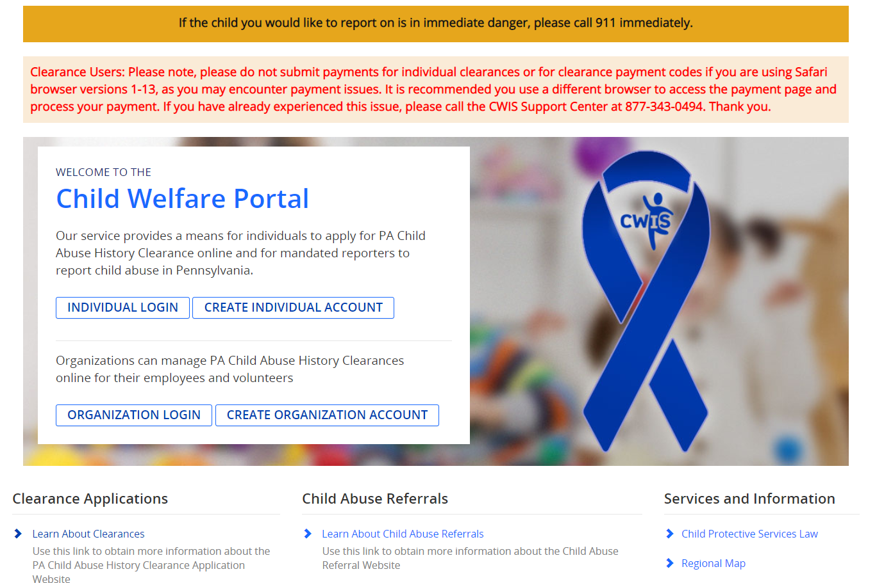
Choose - Create Individual Account for first time users.
Choose - Individual Login for returning users.

Slide 4
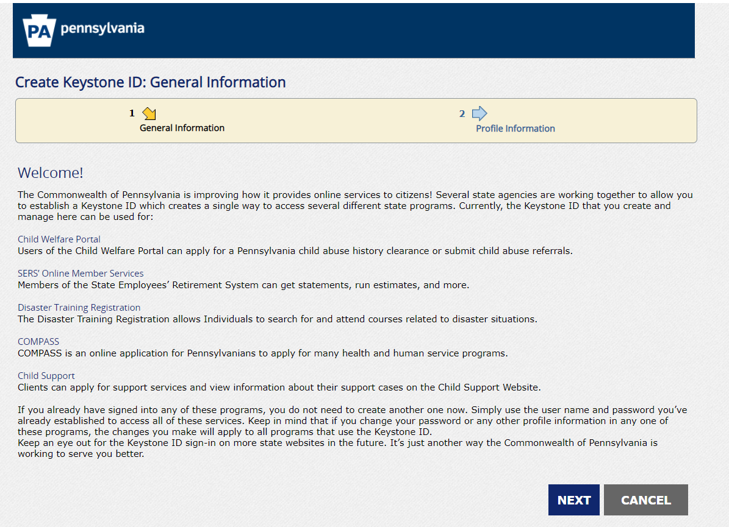
Follow the website through the application process.

Slide 5
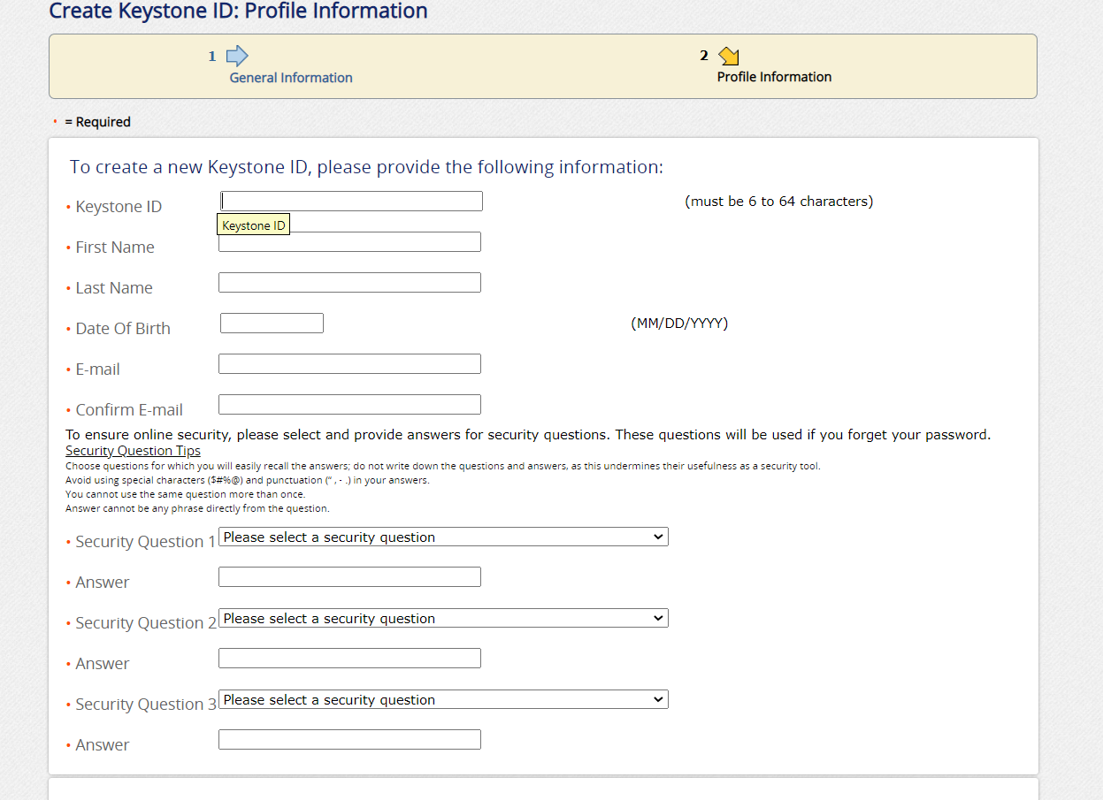
Complete this screen for first time users creating an Individual Account.

Slide 6
When asked for the Application Purpose
Choose the following selection:
Individual 14 years of age or older who is applying for or holding a paid positions an employee with a program, activity, or service, as a person responsible for the child’s welfare or having direct contact with children…….
Complete all the subsequent screens with your personal information.

Slide 7
When you reach the Payment screen – type in the individualized code that was provided by The Borough of Jefferson Hills. This ensures the Borough pays for your PA Child Abuse History Clearance, and you will not be charged.
Submit your application.
Email Meghan Daily with your results of this Clearance – mdaily@jeffersonhills.net

